Slide 1

HTML & CSS
25/12/2023

Slide 2
You don’t HAVE TO USE positions
Sometimes you can position without using position commands

Slide 3
CSS Selectors
+ - only the first brother get the style
> - only the direct child get the style
~ - all the brothers will get the style

Slide 4
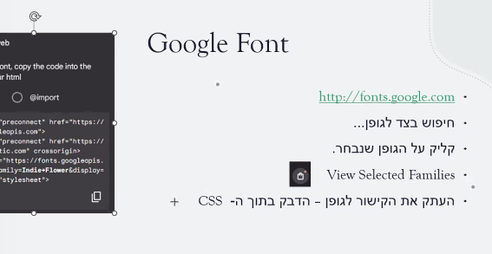
Fonts have to be bought

